Slide 1

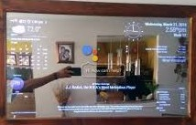
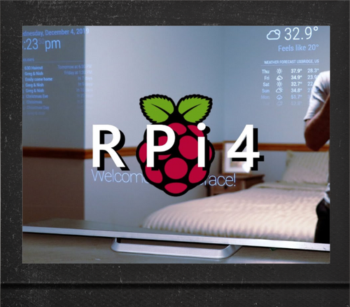
Smart Mirror Automation
Let's Start
Team members Names:
Anbarasu K
Balaji G.C
Karthik .K
M.S.Sankara Naraayanan
YOUR BEST INNOVATION.....

Slide 2


Problem Statement
The major problem of any existing mirror is displaying just the object in front of it or just the human face without having to interact with them. This project is developed with the intention that people spend quality time in front of the mirror

Slide 3

Abstract
Internet of Things (IoT) allows devices to communicate with
each other in different and important places at the same time. Smart things are developed in ways that interact with each other, such as smart doors and smart homes. One of the most important IoT applications is the smart mirror. It is a mirror that acts as a reflective surface and as an interactive screen at the same time. Smart mirrors can be implemented for many fields such as Sport field , Fashion field , Academic field and an assistant in the fitting rooms. This paper presents a view on smart mirrors.

Slide 4


Project’s relevance to today’s society/market/industry
Smart Mirrors have already seen growth in the health and fitness market where they offer a series of exercise routines as part of a smart gym.
In hotels, guestroom Smart Mirrors serve as a standard television set, virtual concierge, or even just a traditional mirror.
smart mirror
Smart Mirrors are being introduced into the automobile market to increase safety. These mirrors are connected to cameras mounted in blind spots to let drivers easily verify that it’s safe to turn or proceed.
Beauty shops can install Smart Mirrors to allow you to browse haircuts, read magazines, or even watch a movie in the mirror while your hair is getting cut or styled.

Slide 5




Why do you need a smart mirror???
Smart mirrors bring you all the functions you need hands-free while getting ready for the day: weather, stocks, traffic, news. It's just like scrolling your smartphone but way more convenient. They can also make a digital television into a stunning design feature by turning it into a mirror while it's off.

Slide 6
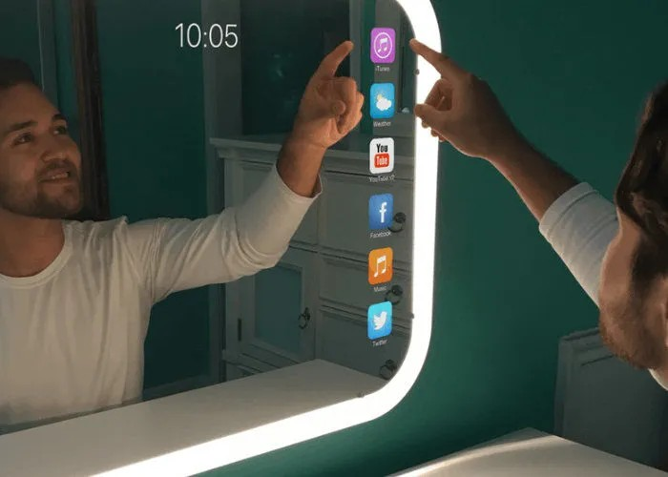

Proposed Solution:
Smart Mirror can provide a series of intelligent experience for the residents, such as controlling all the intelligent furniture through Smart Mirror; accessing and displaying the weather, time, news and other life information; monitoring the home environment; remote interconnection operation..

Slide 7

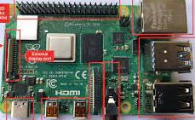
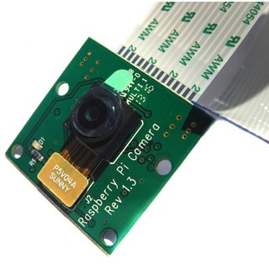



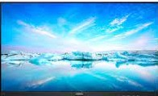
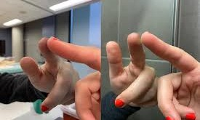
Raspberrypi-4 Board
Something to run the smart- mirror application. ( Most people use a Raspberry Pi)
components of smart mirror
Camera,Microphone
Two-Way Glass mirror
Moniter Display- 15inches

Slide 8
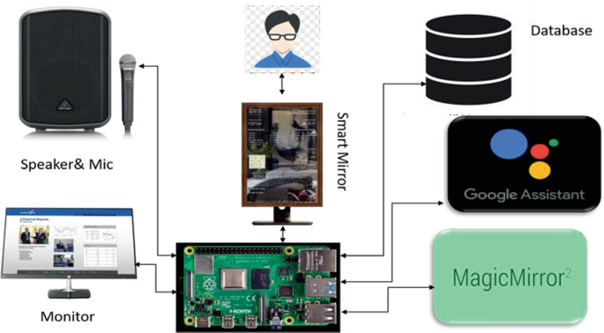

system architecture:

Slide 9
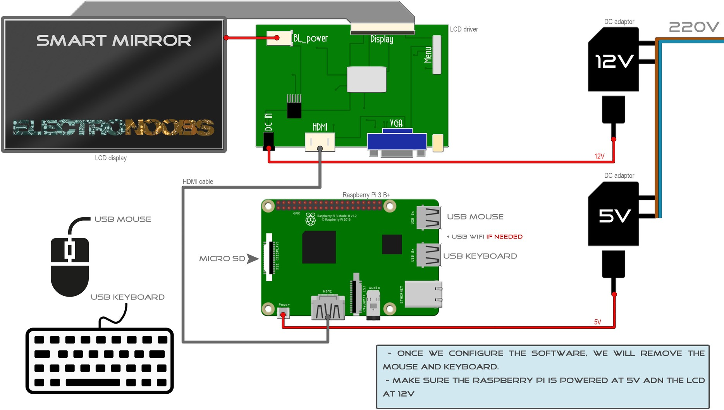
Connection of smart mirror:

Slide 10


Thank you!!
End

